Slide 1
LIBRARY MANAGEMENT SYSTEM USING PYTHON AND MySQL
Supervisor
Prof. Nancy Victor
Assistant Professor, SITE
A J-Component Review 2 by:
Shreyaans Nahata [19BCE2686]

Slide 2
Introduction
With the rapid development of computer technology, the application of computer technology in all walks of life has been widely popular. The development of modern information technology has led to the progress of the library in the direction of automation, network, and digitization.
Due to the increase in the collection of library books and the increasing demand for information, the traditional manual management methods have many shortcomings, the main performance is that the efficiency of handling of borrowing books and returning books process is very low, obviously it cannot adapt to the current information society.
The Library Management System is an application for assisting a librarian in managing a book library. The system would provide basic set of features to add/update members, add/update books, and manage check in specifications for the systems based on the client’s statement of need.

Slide 3
Literature Survey
Author | Contribution | Research Gap
Amin (2003) | Provides information about various open source software for use in libraries like, software tools for automation, software tools for value added services, software tools for digital library initiatives, miscellaneous supporting tools. | Doesn’t mention the cost and resources required to develop and maintain the software.
Eby (2007) | Provides information on some of the available open source library management systems, digital library software, metasearch, link resolvers, federated search engines and OPAC software. | Doesn’t mention the limitations for development of the software.
Hoffman & Yang (2012) | Studies the current usage of next generation online public access catalogues and discovery tools in academic libraries in the USA and Canada. They also reports that use of discovery tool is increasing. The author also provides update on next generation catalogue and discovery tool usage in academic libraries of both countries.

Slide 4
Literature Survey
Author | Contribution | Research Gap
Dartmouth College Library report (2013) | Describes shortcomings of the present generation of library management systems and suggests improvements and inclusion of features in next generation systems like discovery, personalization, Reuse, collection development, collection management, electronic resource management system integration.
Yang (2013) | Describes advanced features of next generation library management systems such as interoperability, electronic resource management, role based login, and other features such as support for different record formats, integration with other system. | Doesn’t mention the vulnerabilities and security risks associated with the software.
Palmer & Choi (2014) | Assesses the state of open source software research in the library context by employing descriptive literature review. They found that most of the significant areas of research are digital repository software, OPAC and integrated library systems.

Slide 5
Modules
Database
book
users
day_to_day
author
category
publisher
User Interface (UI)
Login page
Main UI
Themes
Python Modules
Link to database
Link to GUI

Slide 6



User Interface
Front-End
Login Page
Main UI
Themes
Link to GUI
Python Modules
Middle-End
Link to Database
Database
Book
users
Day_to_day
Back-End
author
publisher
category
Diagram: Architecture Diagram for the Library Management System

Slide 7
Modules Introduction
Databas
Contains the schemas and the data accessed and edited using the GUI.
Book: Schema that stores information about books in the library.
User: Schema that stores information about the users.
Day_to_day: Schema that stores information about the operations carried out by users such as retrieve, rent, withdraw.
Author: Schema that stores information about the authors of the books in library.
Category: Schema that stores information about the categories of the books in library.
Publisher: Schema that stores information about the publishers of the books in library.

Slide 8
Modules Introduction
User Interface
The graphical view of the application for users to interact with.
Login Page: Prompts the users to login upon launching the application.
Main UI: Allows users to edit data in the database.
Themes: Allows users to toggle between themes for the UI.
Python Modules:
The most important part of the application since it allows direct links between the Database and the User Interface.
Link to database: Allows modifying data in the database via python.
Link to GUI: Allows the user to access the database via the GUI.

Slide 9
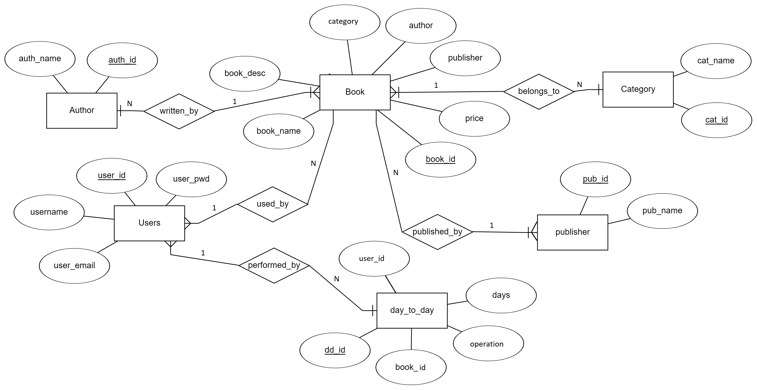
Diagram: Entity-Relation Diagram

Slide 10
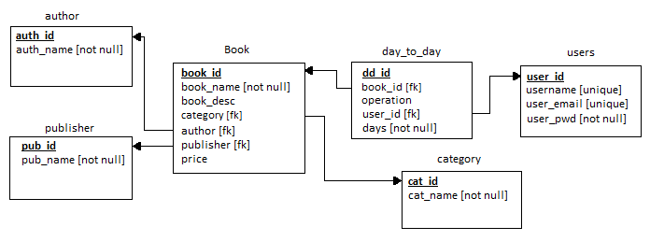
Diagram: Schema Diagram

Slide 11
Normalized Tables
All Tables are in Boyce-Codd Normal Form (BCNF)

Slide 12
Table: Book
TABLE | ATTRIBUTE | DATATYPE | CONSTRAINT
Book | book_id | int | primary key
 | book_name | varchar | unique
 | book_desc | varchar | unique
 | Category | varchar | foreign key category (cat_id)
 | Author | varchar | foreign key author (auth_id)
 | Publisher | varchar | foreign key pub(pub_id)
 | Price | int
Candidate Keys: {book_id, book_name, book_desc}
Functional Dependencies:
Book_id -> {book_id, book_name, book_desc, category, author, publisher, price}

Slide 13
Table: Users
TABLE | ATTRIBUTE | DATATYPE | CONSTRAINT
Users | user_id | int | primary key
 | username | varchar | Unique
 | user_email | varchar | unique
 | user_pwd | varchar | not null
Candidate Keys: {user_id, username, user_email}
Functional Dependencies:
user_id -> {user_id, username, user_email, user_pwd}

Slide 14
Table: day_to_day
TABLE | ATTRIBUTE | DATATYPE | CONSTRAINT
day_to_day | dd_id | int | primary key
 | Book_id | int | foreign key Book (book_id)
 | operation | varchar
 | user_id | int | foreign key Users (user_id)
 | days | int | not null
Candidate Keys: {dd_id}
Functional Dependencies:
dd_id -> {dd_id, book_id, operation, user_id, days}

Slide 15
Table: category
TABLE | ATTRIBUTE | DATATYPE | CONSTRAINT
Category | cat_id | varchar | primary key
 | cat_name | varchar | not null
Candidate Keys: {cat_id, cat_name}
Functional Dependencies:
cat_id -> {cat_id, cat_name}
Table: author
TABLE | ATTRIBUTE | DATATYPE | CONSTRAINT
Author | auth_id | varchar | primary key
 | auth_name | varchar | not null
Candidate Keys: {auth_id, auth_name}
Functional Dependencies:
auth_id -> {auth_id, auth_name}

Slide 16
Table: publisher
TABLE | ATTRIBUTE | DATATYPE | CONSTRAINT
Publisher | pub_id | varchar | primary key
 | pub_name | varchar | not null
Candidate Keys: {pub_id, pub_name}
Functional Dependencies:
pub_id -> {pub_id, pub_name}

Slide 17
User Interface
(Subject to change)

Slide 18
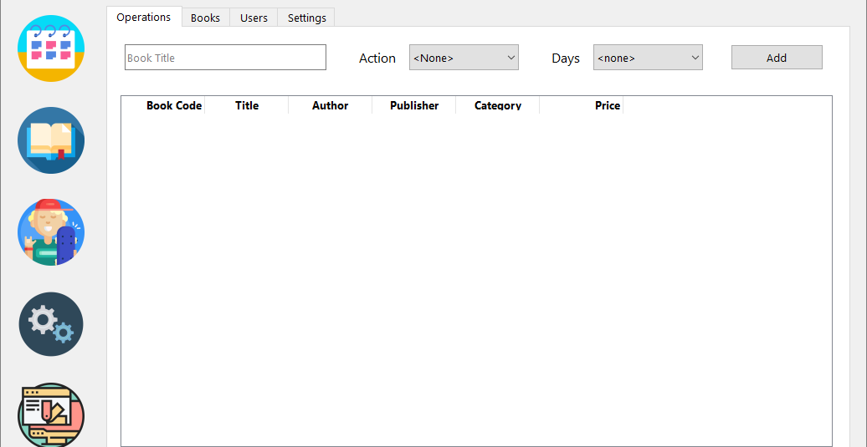
Image: Operations Tab

Slide 19
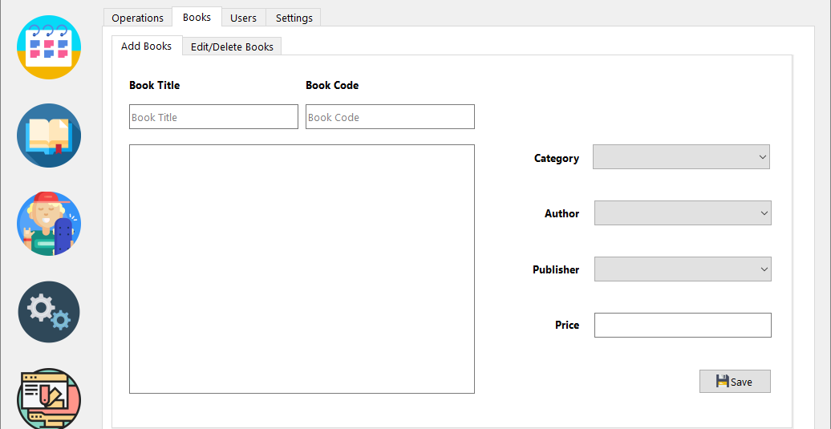
Image: Add Books Tab in the Books Tab

Slide 20
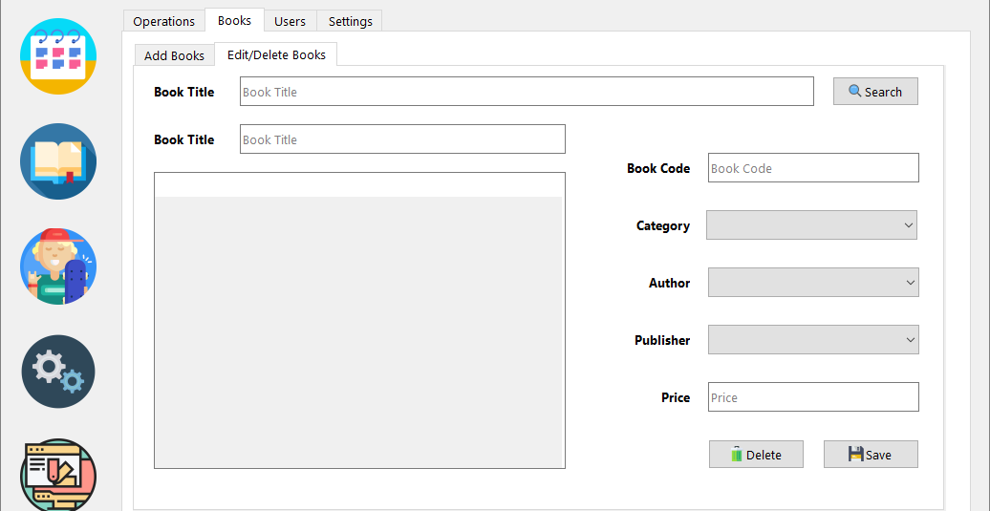
Image: Edit/Delete Books Tab in the Books Tab

Slide 21
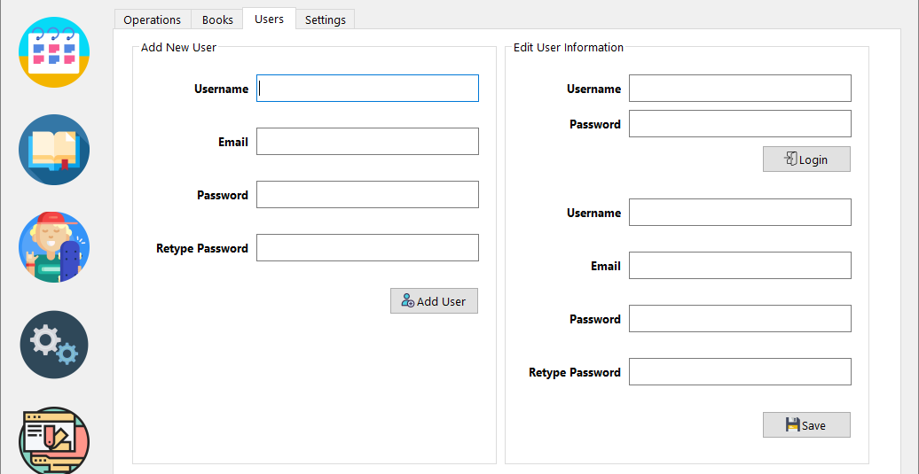
Image: Users Tab with ‘Add New User’ and ‘Edit User Information’ groups

Slide 22
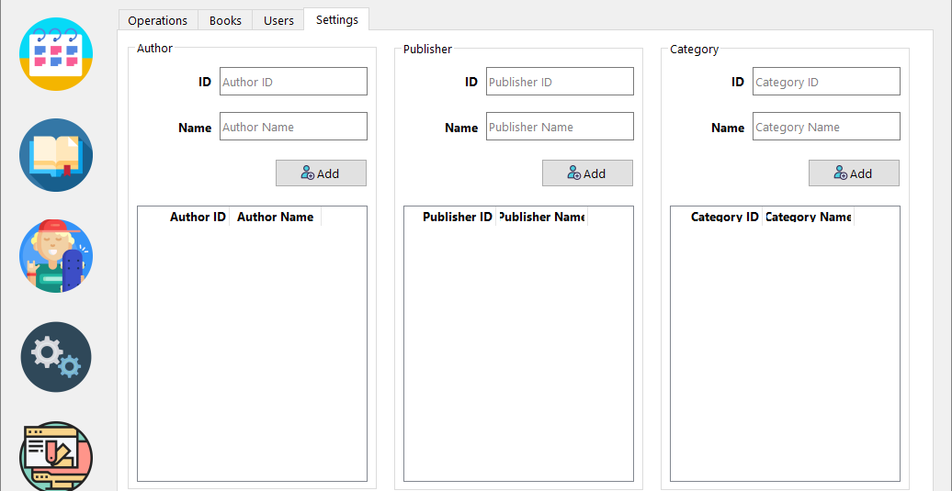
Image: Settings Tab

Slide 23
Database Schemas

Slide 24
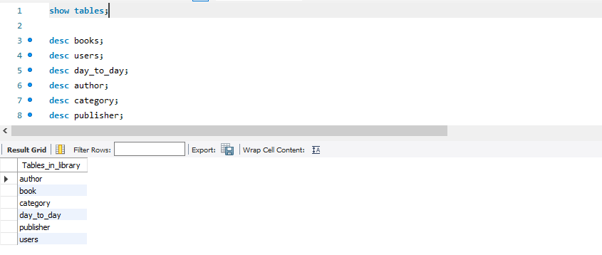
Image: Tables in the database

Slide 25
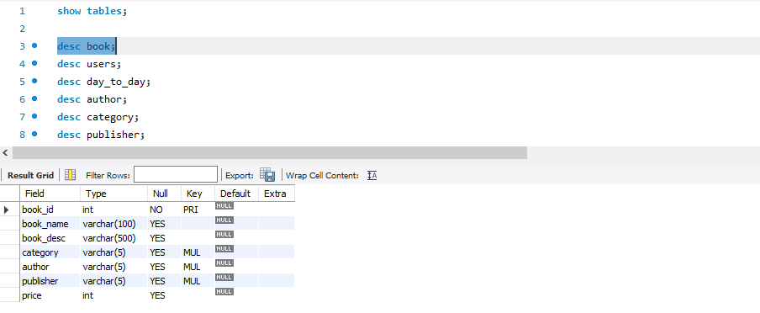
Image: Schema for book table

Slide 26
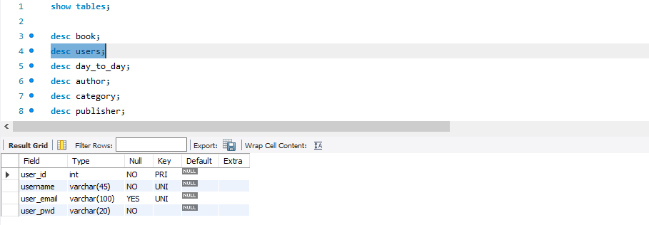
Image: Schema for Users table

Slide 27
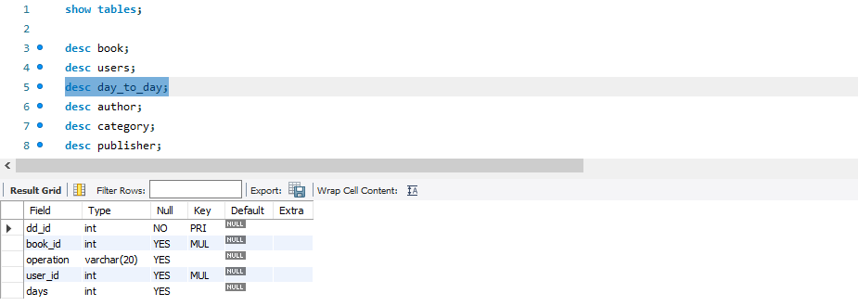
Image: Schema for day_to_day table

Slide 28
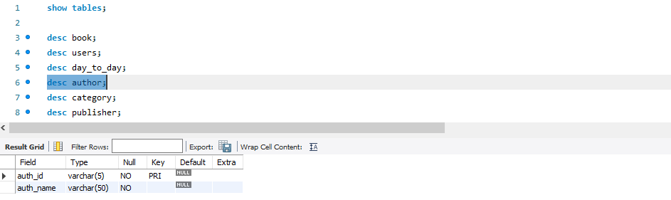
Image: Schema for author table

Slide 29
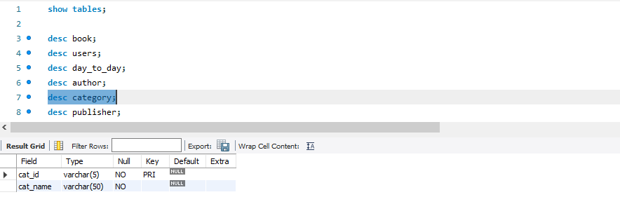
Image: Schema for category table

Slide 30
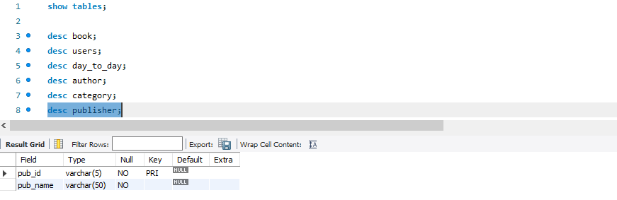
Image: Schema for publisher table

